Slide 1
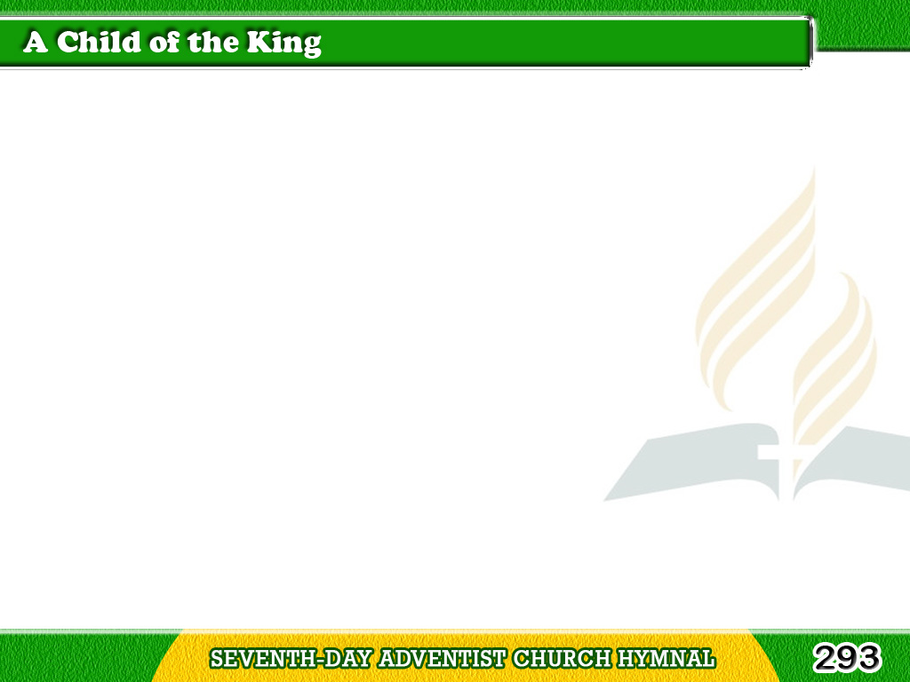
1/4
My Father is rich
in houses and lands;
He holdeth the wealth
of the world in His hands!
Tagalog
Version

Slide 2
1/4
Of rubies and diamonds,
of silver and gold,
His coffers are full
He has riches untold.
Tagalog
Version

Slide 3
1/4
Chorus
I’m a child of the King,
a child of the King!
With Jesus, my Savior,
I’m a child of the King!
Tagalog
Version

Slide 4
2/4
My Father’s own Son,
the Savior of men,
Once wandered on earth
as the poorest of them;
Tagalog
Version

Slide 5
2/4
But now He is pleading
for sinners on high,
And will give me a home
when He comes by and by.
Tagalog
Version

Slide 6
2/4
Chorus
I’m a child of the King,
a child of the King!
With Jesus, my Savior,
I’m a child of the King!
Tagalog
Version

Slide 7
3/4
I once was an outcast,
a stranger on earth,
A sinner by choice,
and an alien by birth!
Tagalog
Version

Slide 8
3/4
But I’ve been adopted,
my name’s written down,
An heir to a mansion,
a robe, and a crown.
Tagalog
Version

Slide 9
3/4
Chorus
I’m a child of the King,
a child of the King!
With Jesus, my Savior,
I’m a child of the King!
Tagalog
Version

Slide 10
4/4
A tent or a cottage,
O why should I care?
They’re building a palace
for me over there!
Tagalog
Version

Slide 11
4/4
Though exiled from home,
yet still I may sing:
“All glory to God,
I’m a child of the King.”
Tagalog
Version

Slide 12
4/4
Chorus
I’m a child of the King,
a child of the King!
With Jesus, my Savior,
I’m a child of the King!
Tagalog
Version

